Slide 1



Renormalization Theory in Quantum Intelligence Unifying Physics, AI, and Intelligent Systems
Dr Saravana Prakash Thirumuruganandham
Director of Research and Development
SIT Health and SMART CO
Catalina aldez y av Portugal
Quito, Ecuador
E mail Saravana@sit.health
Venue, VIT, SCOPE, Vellore, 06/082025
Ignore the noise. Zoom out. Focus on what matters

Slide 2
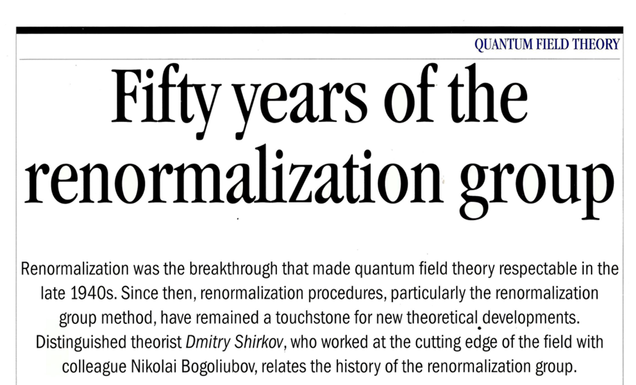

Slide 3


RG filters out small contributions at large scales
Higher powers are almost invisible
All terms matter a bit
The x^4 term completely dominates — others can be ignored.

Slide 4
A qubit is the fundamental unit of quantum information
A superposition is a special state that a qubit can be in
A qubit ≠ superposition
A qubit can be in a superposition
Superposition is a property of qubits
Not all qubits are in superposition

Slide 5

General quantum state of a qubit
A single qubit cannot be entangled entanglement always requires two or more qubits
Entanglement is a property of a system of qubits, not an individual one
The combined state of two (or more) qubits cannot be written as a product of their individual states

Slide 6


Slide 7



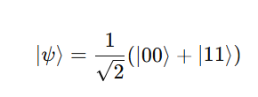

Entanglement - The Cat Is Linked to the Atom
There is a cat locked inside a box.
Inside the box, there's a tiny atom.
If the atom breaks down, it releases poison and the cat dies.
If the atom doesn’t break down, the cat stays alive.
You cannot separate this into “just the atom” state and “just the cat” state. They are linked.

Slide 8
When Does Entanglement Play a Role?
It’s a Bell state, which passes the test for maximal entanglement:
You can't write it as a product.
Measuring the atom tells you the cat's state immediately.
If you measure atom = decayed (1) → cat is dead (1)
If atom = not decayed (0) → cat is alive (0)
Before measurement - Both atom and cat are in a shared, mixed, entangled state. After measurement - The whole system collapses to either |00⟩ or |11⟩.
Entanglement plays a role before measurement not after

Slide 9
What Makes Entanglement Special?
It’s not just about being uncertain. It’s about two systems being uncertain together.
The state of one depends on the state of the other even though both are undefined individually.

Slide 10


How zooming out (RG) helps simplify complex entangled systems, like a quantum cat
The atom is a qubit
The cat is a macroscopic system, but treated as coupled to the qubit
cat is made up of N∼10²⁷ atoms = 2^{N} possible quantum configurations
Full entangled system is mathematically impossible without simplification

Slide 11
RG compresses this information into a macroscopic variable
Two amplitudes again a compressed effective state
Without RG
Simulate every hair on the cat
Store 2^{N} amplitudes
With RG
Track only two outcomes:
Forget the microscopic states keep only the big picture Is the cat alive or dead

Slide 12
RG compresses this information into a macroscopic variable
RG helps quantum computing and physics because it
Reduces overwhelming microscopic data (atoms in cat)
Keeps only effective variables (like alive/dead)
Allows quantum computers to simulate realistic large systems
Component | Quantum Cat System | Quantum Computer
Microscopic Details | 10^{27} atomic qubits in cat | 2^{N} physical qubits
Goal | Determine alive/dead | Predict final outcome / measurement
Without RG | Simulate everything: too hard | Simulate all qubits: exponential memory
With RG | Just track "decayed or not" → “alive/dead” | Only track entanglement structure (e.g. MPS)
RG Output | Macroscopic observable (dead/alive) | Compressed quantum state (MPS/QTT)

Slide 13
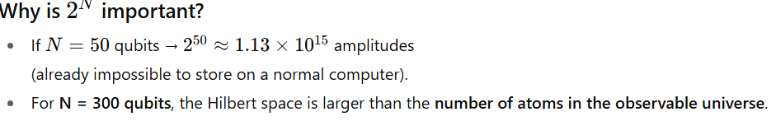
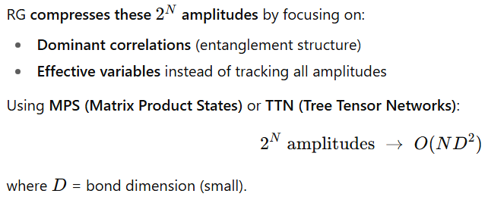
RG compresses this information into a macroscopic variable

Slide 14
RG filters out small contributions at large scales
In training an AI to classify ECG anomalies, you are using a moving average window to reduce the number of training points. What principle is being applied here?
A) Overfitting reduction B) Renormalization C) Signal convolution D) Feature expansion E) Bandwidth estimation

Slide 15
RG filters out small contributions at large scales
you simplify the system by grouping nearby values and removing small fluctuations, i.e., coarse-graining the data

Slide 16
RG filters out small contributions at large scales
A digital signal contains both high-frequency noise and low-frequency clinical trends. To efficiently extract only clinically relevant features, a coarse-graining approach is applied by averaging every 100 consecutive samples. This is conceptually most similar to
01
A) Fourier Transform B) Principal Component Analysis C) Renormalization Group Flow D) Nyquist Sampling E) Histogram Equalization
02

Slide 17
RG filters out small contributions at large scales
Renormalization Group Flow
Explanation This process is like RG flow because you are removing short-distance (high-frequency) fluctuations and focusing on long-range (low-frequency) behavior exactly the idea behind RG in physics.

Slide 18
RG filters out small contributions at large scales
An engineer applies a method that groups every 60 minutes of data into average values to focus on macro patterns in a solar microgrid. This approach is conceptually equivalent to
A) Runge-Kutta integration B) Multi-level wavelet decomposition C) Renormalization Group flow D) Nyquist frequency sampling E) Eigen decomposition of covariance matrix

Slide 19
RG filters out small contributions at large scales
In neural network optimization, a method reduces redundant features layer by layer and keeps only dominant patterns at each scale. This strategy resembles
A) Newton-Raphson descent B) Convolutional upsampling C) Renormalization Group flow D) Naive Bayes simplification E) Dropout regularization

Slide 20
RG filters out small contributions at large scales
You want to compress a video using a smart algorithm that doesn’t just look at pixel-by-pixel compression, but semantic-level compression.
Analyze frames in 16x16 blocks.
Extract features via CNN.
Apply PCA or SVD to drop low-energy modes.
Track how quality degrades.
This hierarchical compression is conceptually like RG remove noise at small scales, keep structure at larger ones.

Slide 21
RG filters out small contributions at large scales
Two departments (Sales and Logistics) are entangled: if Sales increases, Logistics is stressed. Instead of modeling all 1000 sales routes, you focus only on 3 dominant logistics bottlenecks.
This simplification is most similar to
A. Brute-force simulation B. Deep Learning C. Renormalization filtering D. Bayesian belief propagation

Slide 22

RG filters out small contributions at large scales
You model each consumer as a qubit
Over time, user preferences shift due to recommendation influence (entanglement with system state). Applying RG helps you
A. Increase entanglement B. Collapse user state faster C. Track only dominant influences like price, emotion, and timing D. Represent each click as a qubit gate

Slide 23
RG filters out small contributions at large scales
A marketing AI tracks 100 million customers. Each customer has 1000 variables (clicks, age, location, time, etc.). An RG-inspired model groups users by emergent patterns (e.g., time-on-page vs conversion) and compresses input size.
This approach
A. Makes the model slower but more detailed B. Causes information loss at the local level C. Reduces overfitting and enhances generalization D. Increases the number of training parameters

Slide 24
Analogy
Imagine you're building an AI system that has to look at every detail every pixel, every variable, every sensor input. At some point, the system just gets overwhelmed. You need a way to zoom out, focus on what really matters, and ignore the rest. That’s exactly what physicists had to do in the 1940s, when quantum field theory started giving infinite answers. They invented something radical renormalization a way to zoom out without losing meaning. Today, we’ll see how that same logic can help make quantum AI smarter, faster, and more scalable

Slide 25

Analogy
There’s too much information, too much noise, too much happening and it becomes hard or impossible to find what’s actually important.
Just as Indian temples were built from the outside in, starting from complex towers (Gopuram) and moving to the simple core (Sanctum),
AI and quantum systems must also zoom in on the core information filtering out complexity using renormalization and tensor logic
we need shortcuts like renormalization, compression, zooming out, or filtering

Slide 26
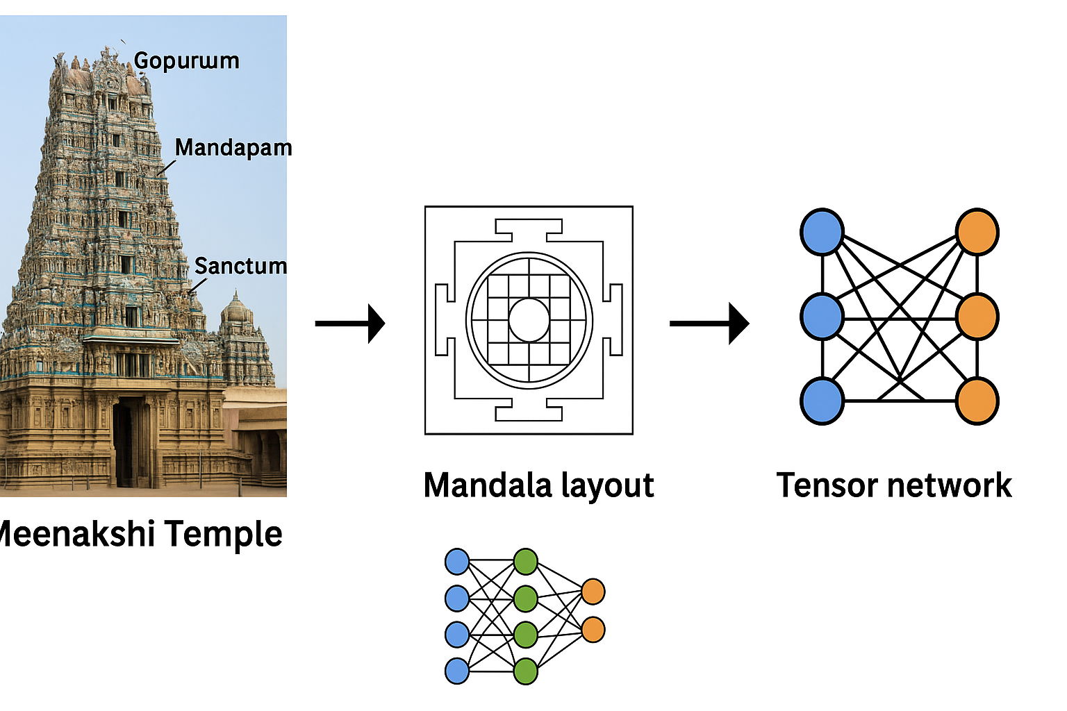
Analogy
The temple has layers of complexity, but its core idea is simple. From chaos to clarity.
This geometric plan shows how ancient temples were designed using symmetric, layered patterns.
A mandala filters out noise and creates ordered space. Like a map that compresses temple complexity into something understandable — this is like renormalization.
Neural Network: Blue to orange nodes with connections mimics how AI learns patterns.
Tensor Network: A structured way to reduce the size of complex quantum systems (used in quantum AI).
These networks also filter, compress, and zoom out just like the temple layout or renormalization in physics.

Slide 27
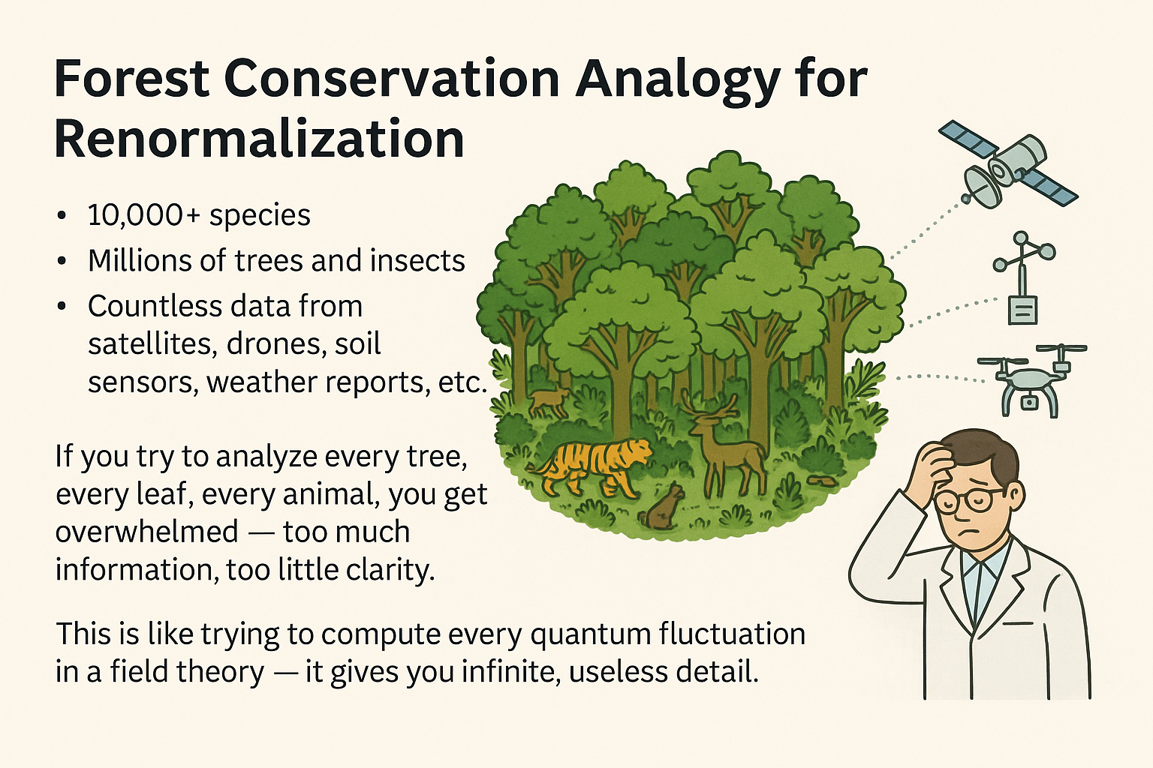
Analogy
Trying to conserve a forest by tracking every leaf is overwhelming. But when you zoom out, spot patterns, and focus on the right scales, you protect the whole system smartly, efficiently, and meaningfully. That’s renormalization. In forests, physics, or AI.

Slide 28
A team of forest conservationists is overwhelmed with data from millions of individual trees, species, and climate sensors in a dense rainforest. To simplify their analysis, they adopt a "zoom-out" strategy that focuses on large-scale indicators like
Zone classification (wet/dry/edge),
Monitoring of selected animal species,
Aggregate CO₂ absorption metrics.
Which of the following best describes the approach they are using?
A. Linear Regression Modeling B. Renormalization or Dimensionality Reduction C. Deep Feature Amplification D. Localized Biodiversity Exhaustion E. Random Sampling Without Replacement

Slide 29
Difference
Classical Data Science Approach
Use all available data Build large models with hundreds of variables Try to find patterns from the full dataset
Renormalization-Inspired Approach
Inspired by physics: discard small-scale fluctuations, focus on effective behavior Emphasizes scaling, hierarchy, and emergent patterns Uses only the most relevant variables at the right scale

Slide 30
Difference
Problem | Classical Approach | Renormalization Approach
Curse of Dimensionality | Needs exponentially more data | Works with fewer, scaled variables
Overfitting Risk | High (more features → more noise fit) | Low (only core structure remains)
Model Complexity | O(n²) or O(n³) in large systems | O(log n) or constant time models
Entropy & Information Theory | High entropy, low signal-to-noise ratio | Lower entropy, higher information density
Scalability | Poor — bottlenecked | Excellent — scalable to large forests or fields

Slide 31
Difference
Mathematically, renormalization acts like Principal Component Analysis (PCA) or Fourier filtering — projecting data onto basis states that matter most
In classical ML: 100 variables → model size = O(100²) = 10,000
In renormalized quantum ML use entangled states, retain only low-rank tensor structure
Huge savings in compute + noise reduction

Slide 32
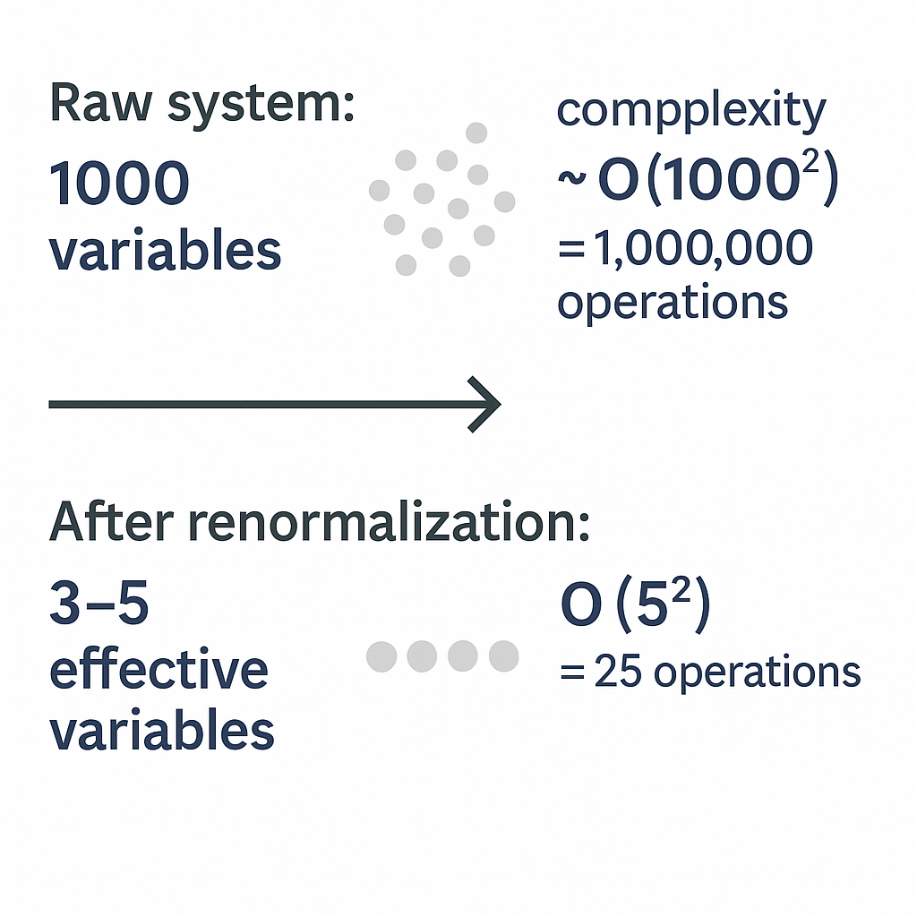
Difference
Classical data science memorizes the noise.
Renormalization finds the structure saving millions of computations and retaining only what actually governs the system.

Slide 33
Difference
Method | Uses All Variables? | Overfits? | Generalizes? | Computational Cost
Classical Data Science | Yes | Often | Weak | 🔺 O(n²) or worse
Renormalization Logic | No — filters noise | Robust | Strong | 🔻 O(log n) or low
Raw system: 1000 variables → complexity ~ O(1000²) = 1,000,000 operations
After renormalization: 3–5 effective variables → O(5²) = 25 operations
~40,000× compression, while retaining governing structure

Slide 34
Suppose you're modeling tree height in a forest
You collect data from 10,000 trees
TreeHeight depends on:
SoilNutrients (X₁)
Sunlight (X₂)
Rainfall (X₃)
997 other sensor variables: X₄ to X₁₀₀₀
Only X₁ to X₃ matter. The rest is noise or irrelevant.

Slide 35
Classical Data Science Approach
TreeHeight=f(X₁,X₂,...,X₁₀₀₀)+ϵ
Model tries to use all 1000 features.
Might fit to noise in X₄ to X₁₀₀₀.
Needs O(n²) to O(n³) computations (where n = features = 1000).
Overfits. Fails to generalize.

Slide 36
Renormalization-Inspired Strategy
Step 1: Zoom Out / Reduce Dimensions
Use PCA, Fourier, or physics intuition
Identify only 3 governing variables: X₁, X₂, X₃.
Or combine them into 1–2 effective variables:
Z1=0.5X1+0.3X2+0.2X3
Step 2: Model only effective behavior:
TreeHeight≈g(Z1 )
computation: O(3²) = 9 ops vs. O(1000²) = 1,000,000+
No overfitting.
Better generalization across zones and regions.

Slide 37
Why Classical Memorizes Noise
Classical ML treats all input dimensions equally.
If many are irrelevant or weakly correlated, it still builds complex decision surfaces using them.
This "fits the training data" but learns patterns that don’t generalize — i.e., memorizes noise.
Why Renormalization Finds Structure
It assumes Nature works at different scales.
Instead of every detail, it asks
What combination of inputs really controls the system?
It projects data onto meaningful, low-dimensional subspaces (like in:PCA (eigenvalue filtering), RG flow (scale collapse), Tensor networks (low-rank approximations)

Slide 38
Percentage reduction
A machine learning system originally uses 1000 input variables, resulting in a complexity of O(1000^2)). After applying a renormalization-inspired reduction, the system now uses only 5 effective variables.
What is the approximate percentage reduction in the number of operations?
A. 50% B. 90% C. 99.5% D. 99.9975% E. 100%

Slide 39
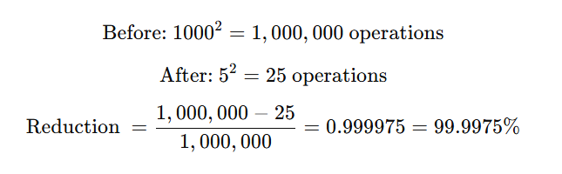

Slide 40
Analytical Reasoning
Researchers studying a rainforest collect thousands of variables from sensors and species trackers. However, they discover that tree height can be effectively predicted using just three aggregate variables: rainfall, sunlight, and soil nutrients. Which of the following best explains their modeling decision?
A. They are avoiding overfitting by applying dropout B. They are using k-means clustering to reduce the sample size C. They are applying renormalization to extract effective structure D. They are removing bias using L1 regularization E. They are improving interpretability using random forests
They are applying renormalization to extract effective structure

Slide 41
Mathematical Reasoning
Let the cost of computation for a model be proportional to the square of the number of variables used: Cost=O(n2)
Which of the following variable reductions would reduce the computational cost by a factor greater than 10,000?
A. From 500 variables to 100 variables B. From 1000 variables to 50 variables C. From 1000 variables to 10 variables D. From 1000 variables to 5 variables E. From 200 variables to 20 variables

Slide 42
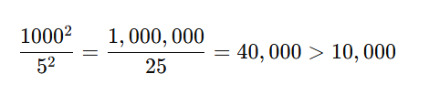

Slide 43

Computational Engineering – Heat Simulation in a Complex Material
An engineer simulates heat diffusion in a composite material with 1000×1000 grid points = 1 million nodes , Each node has 10 properties (temperature, conductivity, pressure, etc.) Governing equation (e.g. Finite Element Method)
Tries to simulate every node and every variable
Complexity grows as O(n^2) or worse
Requires high-performance computing (HPC) cluster
❌ Expensive, slow, and hard to interpret

Slide 44

Renormalization-Inspired Engineering
Instead of simulating all nodes
Group regions with similar behavior (coarse graining)
Track macrozones regions with similar temperature gradients
Extract effective conductivity keffk​ and macro-heat flow Qeff
Use multi-scale modeling or homogenization
10×10 coarse grid instead of 1000×1000 Retains key behavior Simulation cost drops from O(10^6) to O(10^2)

Slide 45
Renormalization-Based Engineering
Feature | Classical FEM/CFD | Renormalization-inspired
Nodes Simulated | 1,000,000 | 100–200 macro-nodes
Complexity | O(n²) | O(k²), where k ≪ n
Time to Solve | Hours or days | Minutes
Interpretable Behavior | Hard | Clear macro-laws
Adaptability | Poor | Multi-scale ready

Slide 46
Renormalization-Based Engineering
An engineer models heat flow in a large mechanical structure using 1 million nodes. They switch to a renormalization-inspired model that clusters regions and simulates only 100 macro-nodes. Assuming computational complexity is proportional to the square of the number of nodes, what is the approximate reduction in operations?
A. 10× B. 100× C. 1,000× D. 10,000× E. 1,000,000×

Slide 47
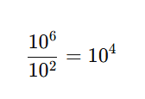
Renormalization-Based Engineering
In computational engineering, renormalization helps simplify large simulations by identifying effective parameters at the right scale.
It allows engineers to move from microscale chaos to macroscale insight — with massive computational savings

Slide 48
Renormalization-Based Engineering
A hospital AI is trained to detect early sepsis. It initially uses 300 signals per patient, but then applies a method to compress them into 5 latent variables while retaining 97% of predictive power. This resembles:
A. Linear regression B. Decision trees C. Renormalization group method D. t-SNE visualization E. Logistic regression
Renormalization is not just for quantum physics. It can be the foundation of a next-gen medical startup that deals with big health data, focuses on emergent patterns, and delivers interpretable, scalable AI

Slide 49
Renormalization-Based Engineering
Supply Chain Reaction Modeling
Factories, logistics hubs, and retailers are like oscillators.
Delay or disruption at one node affects the entire chain (bullwhip effect).
SHM models help in inventory oscillation prediction and resilience modeling
Application: Amazon, Walmart, Tesla’s EV supply optimization

Slide 50
Renormalization-Based Engineering
Amazon , Supply Chain Oscillations & Demand Propagation
Uses system dynamics and coupled models to manage
Inventory across fulfillment centers
Delays and ripples in logistics
Customer demand response over time
Equivalent to oscillator chains a disruption at one node (delivery center) propagates
Renormalization Logic Aggregates demand by region or category to avoid computation overload

Slide 51
Renormalization-Based Engineering
Company | What They Do
Google DeepMind | Uses renormalization group theory for neural net scaling (e.g., AlphaFold, AlphaGo)
IBM Quantum | Uses renormalization in tensor networks for quantum circuit compression
Palantir | Aggregates low-level data into macro patterns — same logic as renormalization
Airbnb | Uses zone-level market models to simplify demand/supply planning

Slide 52

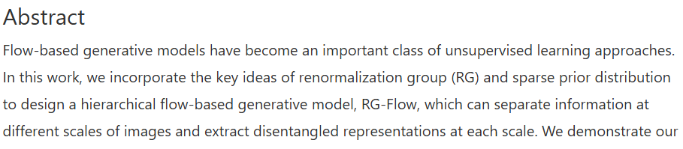
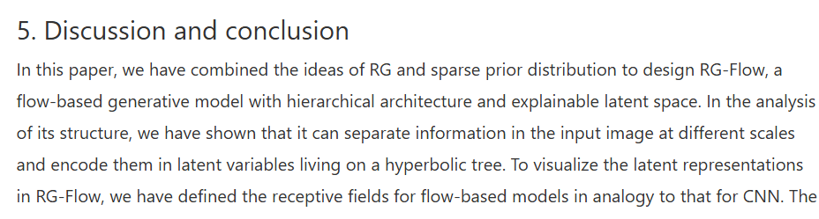
Renormalization-Based Engineering

Slide 53
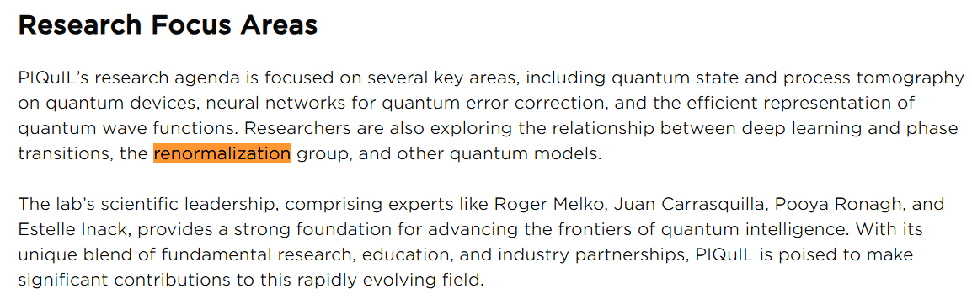
Perimeter Institute Quantum Intelligence Lab (PIQuIL)

Slide 54
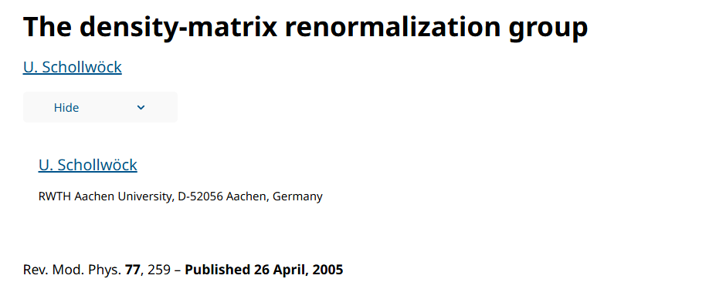
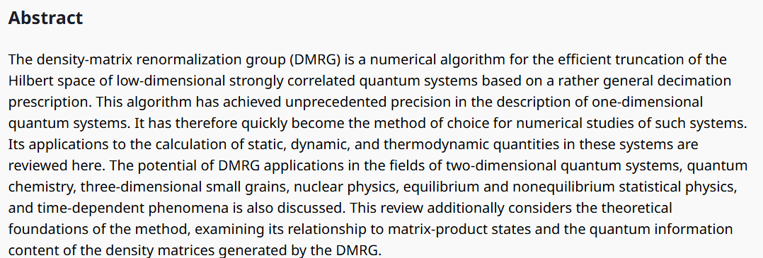
Multiverse Computing (Spain/Canada)
RG Signature They use Matrix Product States (MPS) and DMRG-like structures, which are formal RG tools from quantum physics.

Slide 55
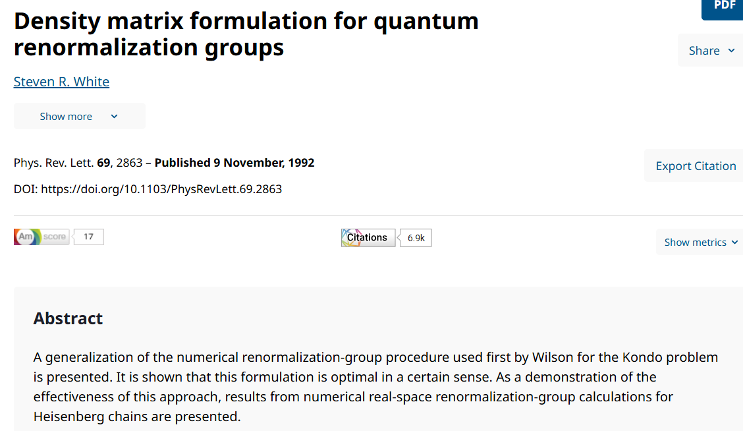
Multiverse Computing (Spain/Canada)
RG Signature They use Matrix Product States (MPS) and DMRG-like structures, which are formal RG tools from quantum physics.

Slide 56
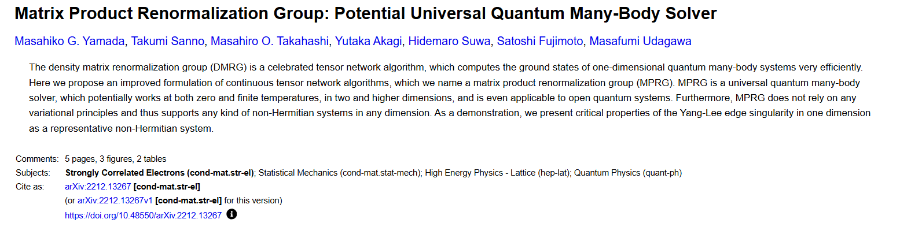
Multiverse Computing (Spain/Canada)

Slide 57
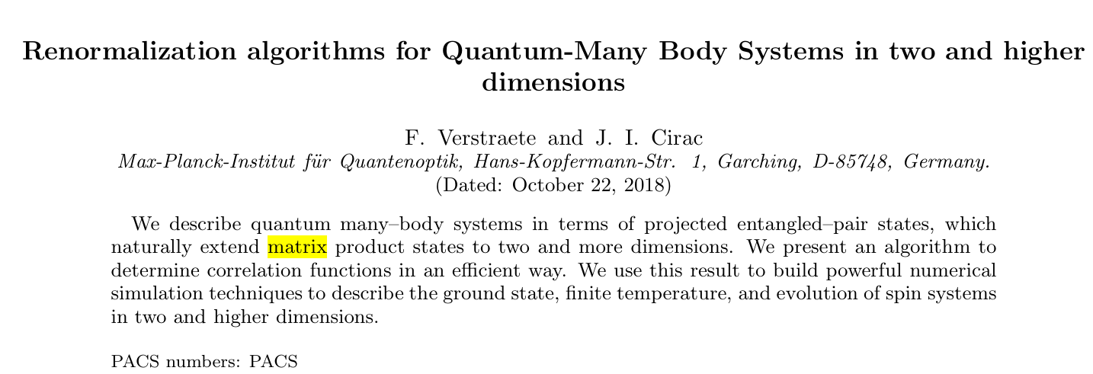
Multiverse Computing (Spain/Canada)
RG Signature They use Matrix Product States (MPS) and DMRG-like structures, which are formal RG tools from quantum physics.

Slide 58
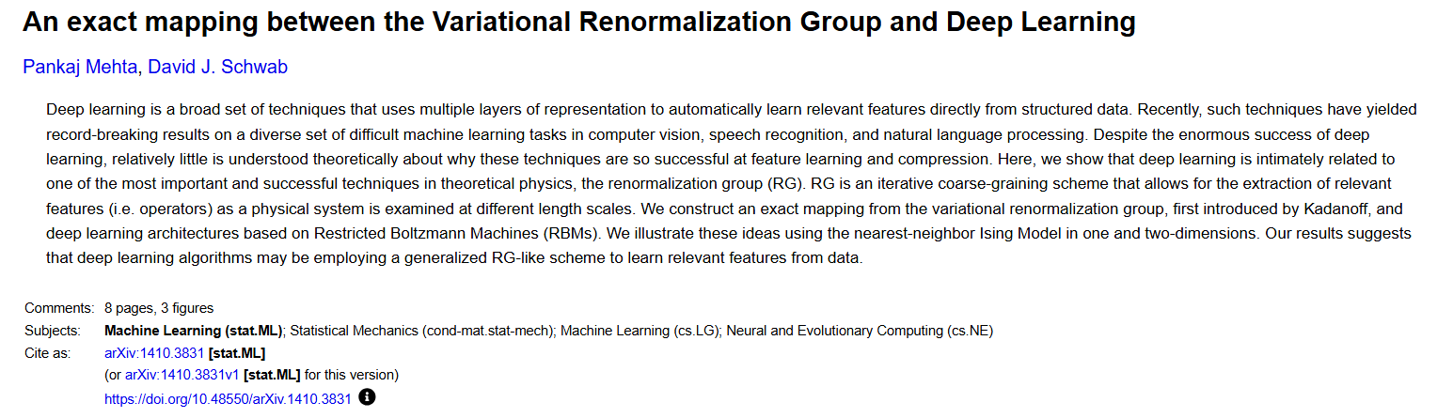
DeepMind (Alphabet / Google)
AlphaFold protein folding tool and physics-informed AI models use hierarchical representations, mimicking RG flow across energy or spatial scales
RG Signature Uses implicit scale transformations to encode physical laws across multiple biological scales (amino acid → structure → dynamics)

Slide 59
Provider / Focus | Article / Resource | RG‑style Hierarchy
Schrödinger / NVIDIA (industrial) | MS CG platform documentation | Electronic → atomistic → mesoscale → macro
QCWare / quantum interactions | “Coarse-grained intermolecular interactions on quantum processors” (2021) | Coarse-grained electronic response via VQA
Noid et al. (2008) | Formal multiscale CG method bridging atomistic ↔ CG models | Rigorous projection / ensemble matching
Wang et al. / CGnets (2019) | Deep‑learning-based CG free‑energy model | Learned coarse forces approximating atomics
Husic et al. (2020) | Graph‑neural coarse‑graining learning representations & dynamics | Hierarchical learned model
Lyu & Lei (2023) | Mori‑Zwanzig ML-based CG MD with memory functions | Projection retaining many‑body memory terms
RG Signature Hierarchical approximations reduce compute cost while preserving chemical accuracy.
NVIDIA / Schrödinger Inc. / QCWare (Materials + Drug Discovery)

Slide 60
Renormalization-Based Engineering
Startup | Domain | RG-like Practice
nference | Biomedical data fusion | Compresses EHR + genomics into latent representations (effective variables)
Tempus | Oncology AI | Reduces high-dimensional genetic + clinical data into actionable predictive scales
Qure.ai | Radiology | Extracts hierarchical features in brain/chest images, bypassing local pixel noise

Slide 61
Renormalization-Based Engineering
RG Theory (Physics) | Commercial Equivalent
Coarse-graining | Dimensionality reduction / PCA
RG Flow | Layered feature abstraction (NN)
Fixed points | Disease phenotypes / outcomes
Relevant variables | Biomarkers / macro patterns
DMRG / MPS | Tensor compression in QML/AI

Slide 62


Renormalization-Based Engineering

Slide 63
Thanks

